Slide 1
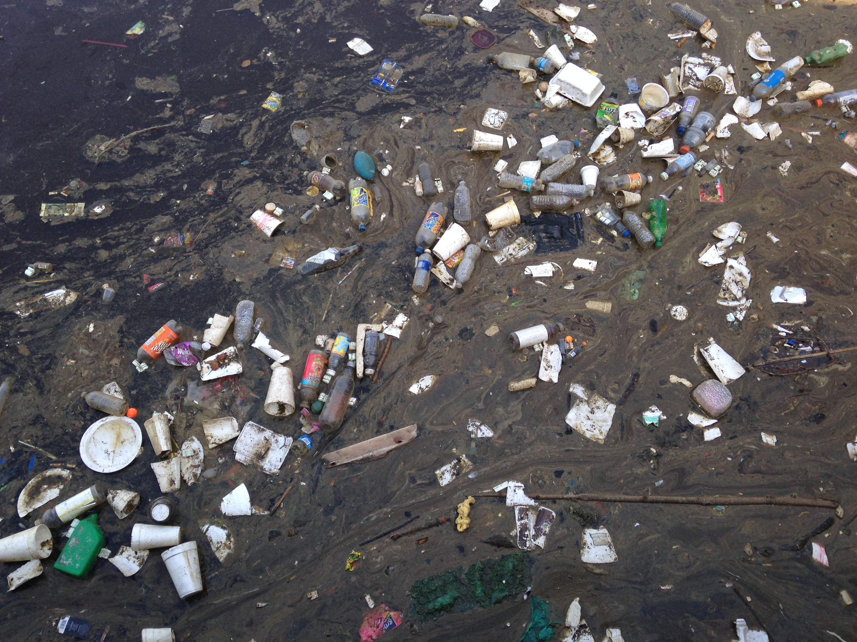
The Problem
Trash not properly disposed of endangers our local wildlife and the environment. Each year over 300,000 pounds of trash is collected from the Chesapeake Bay and its tributaries.
Baltimore Harbor, 2015

Slide 2
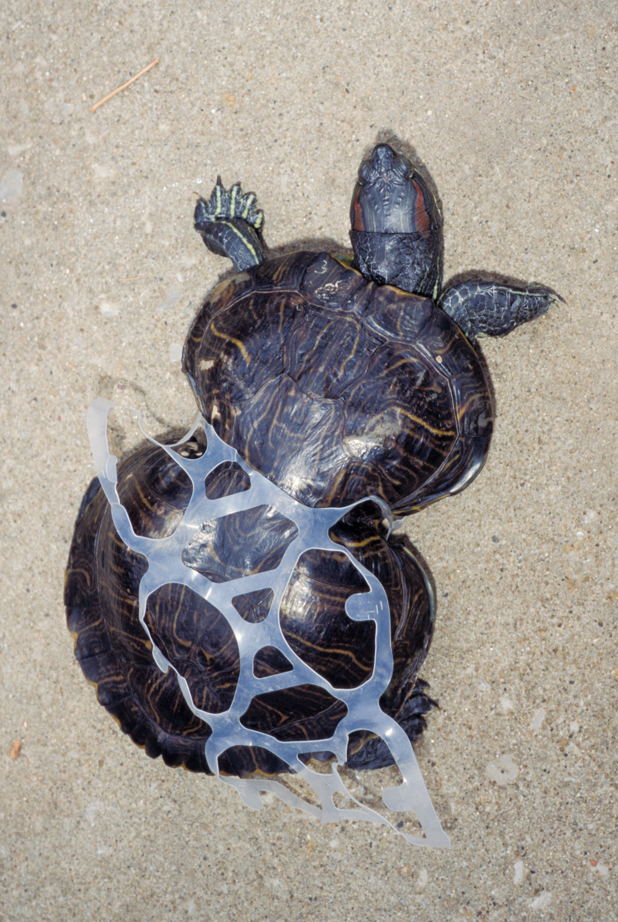
Consequences
1
Litter and trash not properly disposed of negatively impacts over 265 species of wildlife!
2
Wildlife can become entangled, have trouble breathing, eating, escaping predators, and swimming.
Wildlife often mistake trash for food. Litter can fill their stomachs and cause intestinal blockage, causing the animal to starve to death.
3
The average Marylander throws away 7lbs of trash each day. The choices YOU make each day affects the health of the Chesapeake Bay.

Slide 3
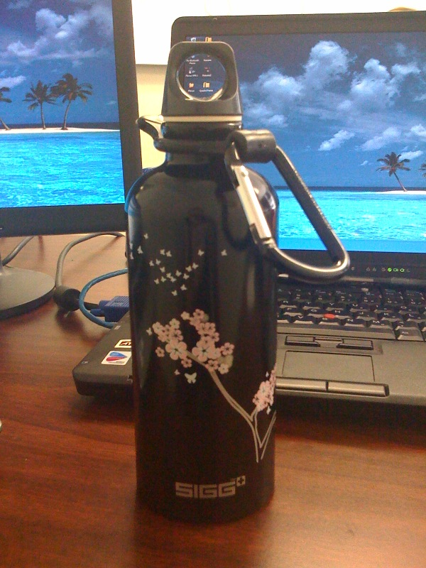
1
What Can You Do about It?
Reduce, Reuse, Recycle
Reduce Waste
Create less trash by making the choice to avoid disposables and over-packaged items.
Reuse
Reuse, pass along, or donate items that are still useful.
Recycle
Participate in your local recycling programs.

Slide 4
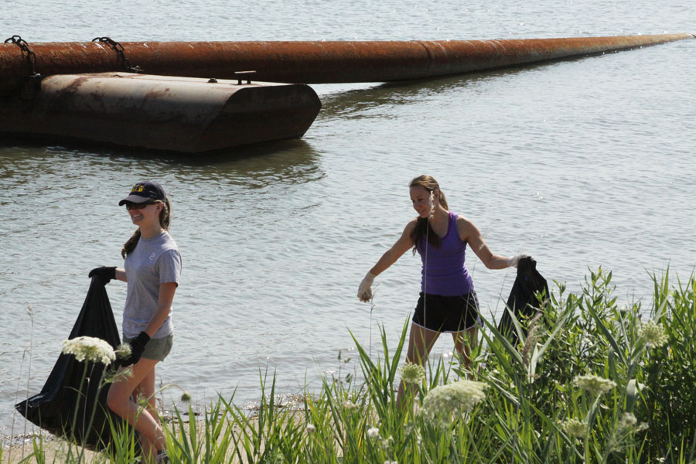
2
What Can You Do about It?
Don’t Litter &
Pick Up Trash
Properly dispose of your trash
Organize a trash clean-up in your community
Pick up trash that you see on the ground

Slide 5
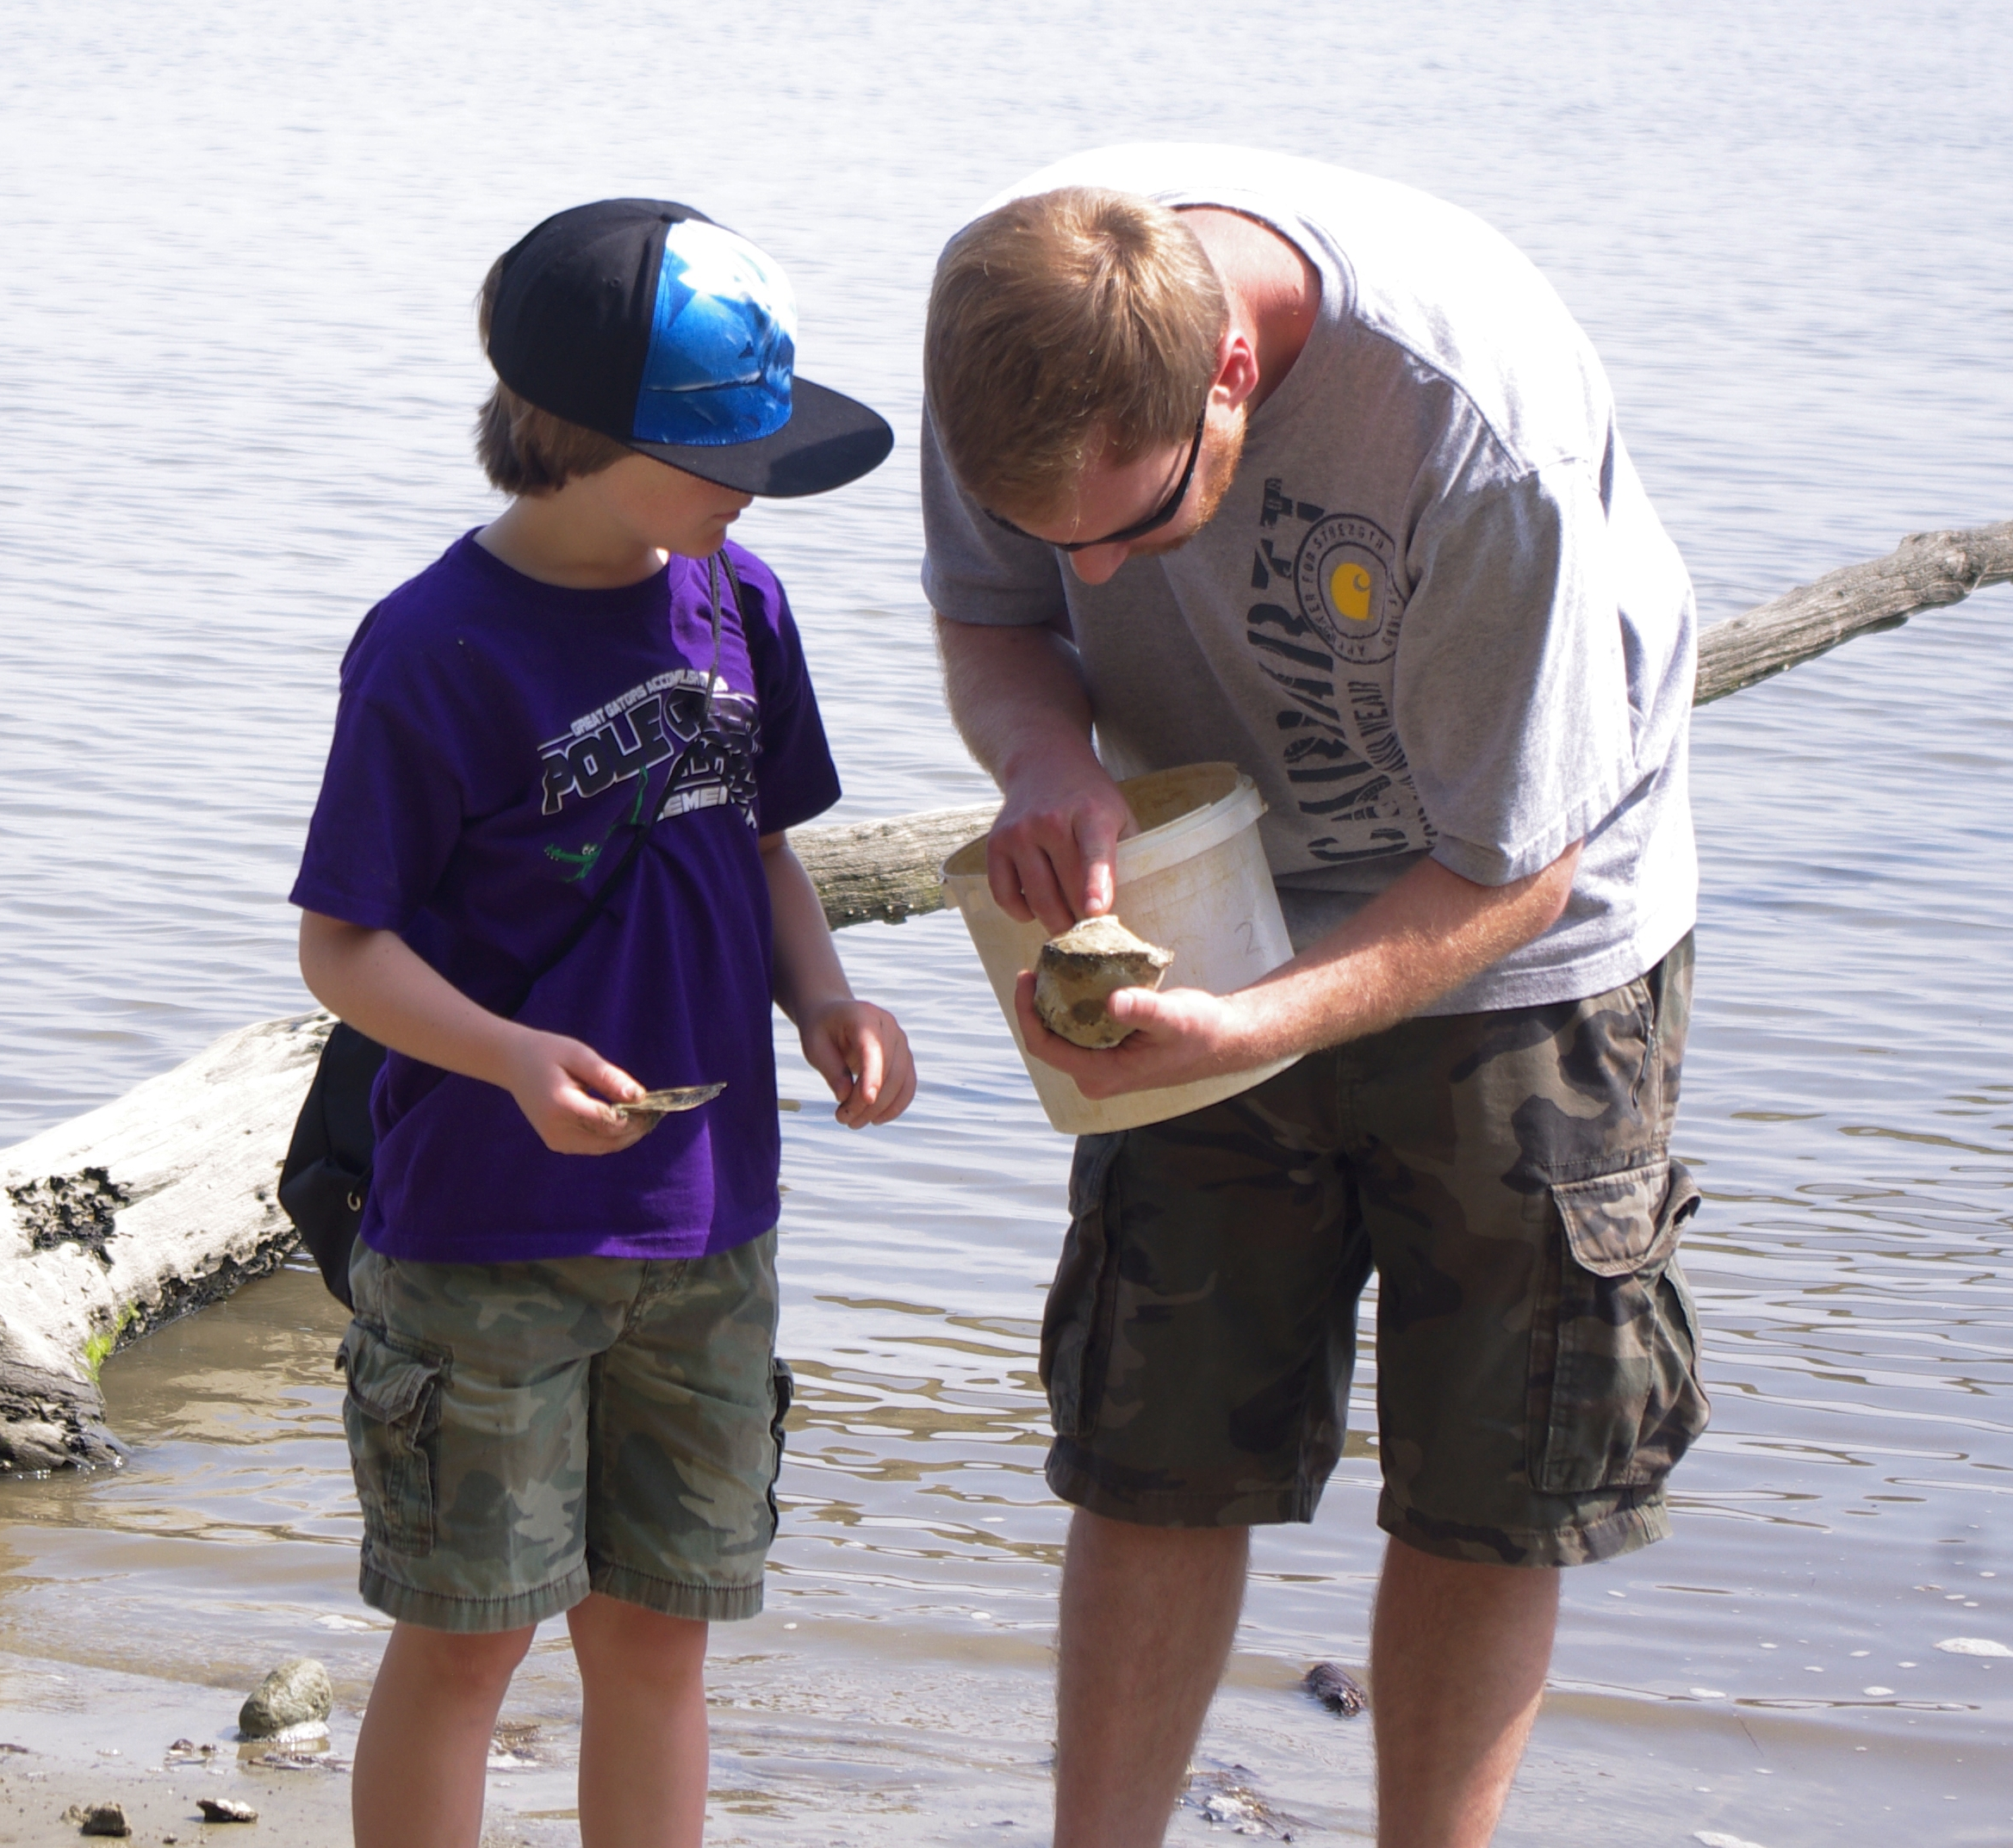
3
What Can You Do about It?
Educate Others
Make a difference by sharing what you know with others.
Teach them the importance of making positive choices for the Chesapeake Bay and that one piece of litter can negatively impact the environment and local wildlife.

Slide 6
Credits
“Litter in the Chesapeake Bay” courtesy Leila Hadj-Chikh
“Peanut the Red Eared Slider” courtesy Missouri Department of Conservation
Photos used under Creative Commons licenses:
https://creativecommons.org/licenses/by/2.0/legalcode
“110603-A-ON889-047 - Clean The Bay Day” by U.S. Army Corps of Engineers via flickr.com
“Field Education on the River” by vastateparkstaff via flickr.com
https://creativecommons.org/licenses/by-nc-nd/2.0/legalcode
“SIGG Water Bottle” by Christine Krizsa via flickr.com

